Slide 1
ATAI
Advanced Technique of Artificial Intelligence
ATAI
ChongqingUniversity _{AdvancedTechniqueof}
of Technology Artificial Intelligence
Chongqing University of Technology
Chongqing University ^{ATAI}
_{of Technology} Advanced Techniqueof
Artificial Intelligence
Chongqing University of Technology
Chongqing University of Technology
Dynamic Mixture-of-Experts for Incremental Graph Learning
Code: NONE
2025.3.17•ChongQing
——ICLR 2025
Reported by Lele Ren
1

Slide 2
ATAI
AdvancedTechniqueof
Artificial Intelligence
ATAI
ChongqingUniversity _{AdvancedTechniqueof}
of Technology Artificial Intelligence
ChongqingUniversity of Technology
Motivation
When dynamic graph data expands over time, traditional methods (e.g., retraining the entire graph) that directly fine-tune all graphs lead to catastrophic forgetting. Existing approaches treat old data as an indivisible whole and fail to account for correlations between new and old data chunks. For instance, new chunks may be isolated from or connected to old ones, but current methods uniformly process all historical knowledge, resulting in negative transfer or forgetting.

Slide 3
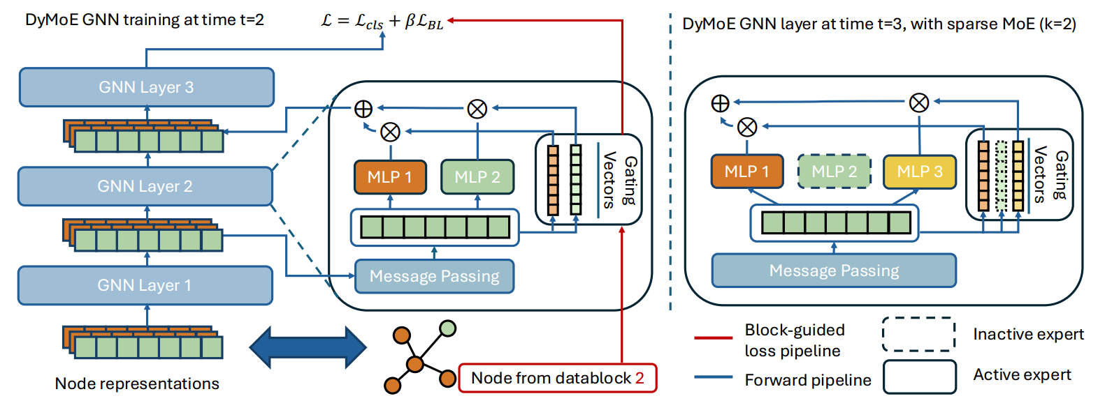
ChongqingUniversity of Technology
ATAI
AdvancedTechniqueof
Artificial Intelligence
ATAI
ChongqingUniversity _{AdvancedTechniqueof}
of Technology Artificial Intelligence
Overview

Slide 4
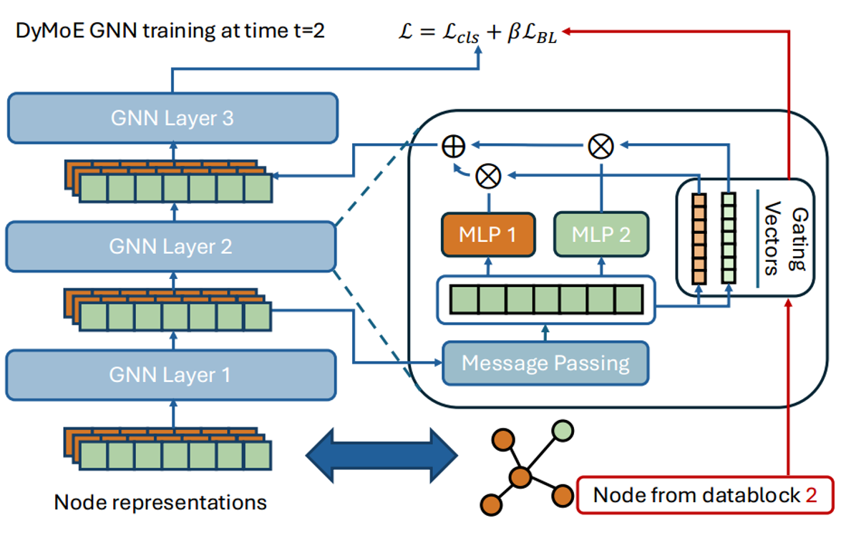
ChongqingUniversity of Technology
ATAI
AdvancedTechniqueof
Artificial Intelligence
ATAI
ChongqingUniversity _{AdvancedTechniqueof}
of Technology Artificial Intelligence
Method

Slide 5
ChongqingUniversity of Technology
ATAI
AdvancedTechniqueof
Artificial Intelligence
ATAI
ChongqingUniversity _{AdvancedTechniqueof}
of Technology Artificial Intelligence
Method

Slide 6
ChongqingUniversity of Technology
ATAI
AdvancedTechniqueof
Artificial Intelligence
ATAI
ChongqingUniversity _{AdvancedTechniqueof}
of Technology Artificial Intelligence
Method

Slide 7
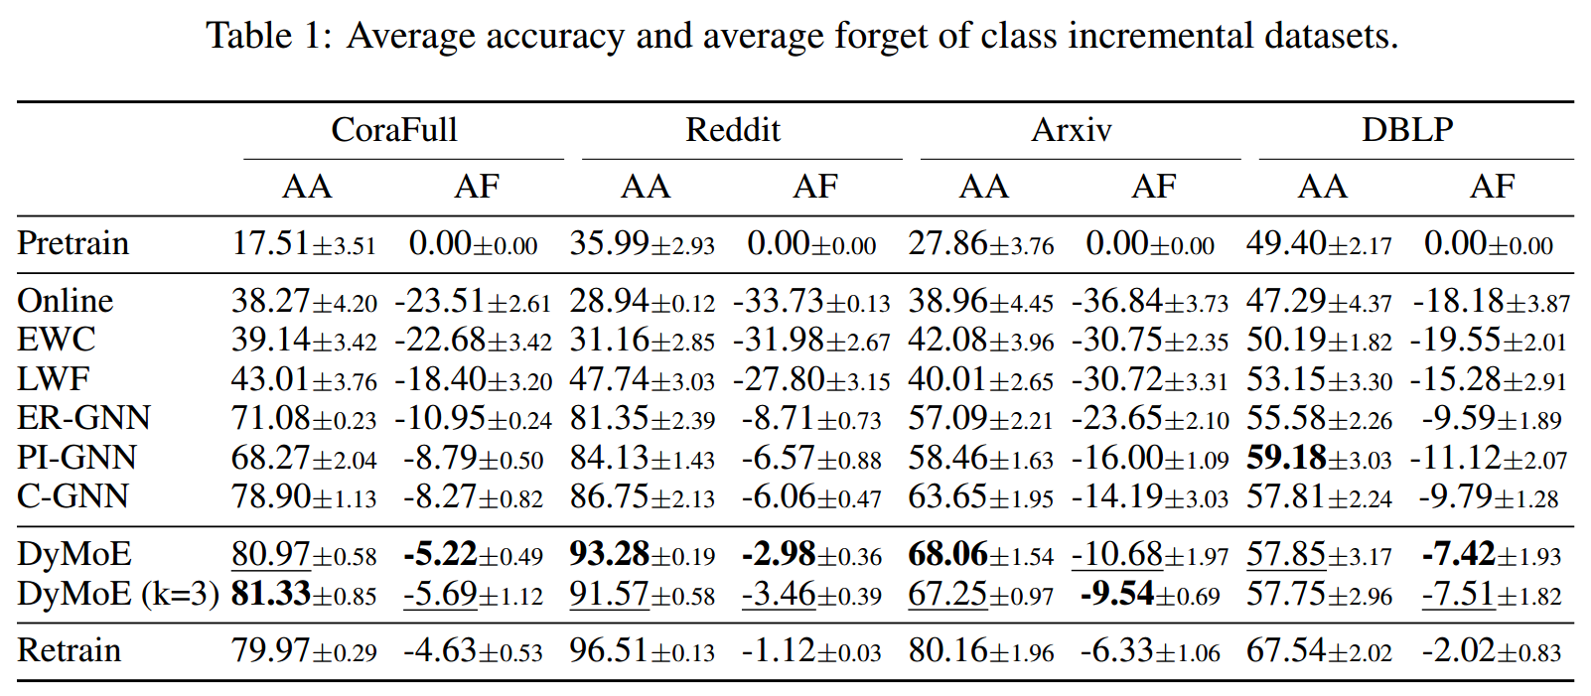
ATAI
AdvancedTechniqueof
Artificial Intelligence
ATAI
ChongqingUniversity _{AdvancedTechniqueof}
of Technology Artificial Intelligence
ChongqingUniversity of Technology
Experiments

Slide 8
ATAI
AdvancedTechniqueof
Artificial Intelligence
ATAI
ChongqingUniversity _{AdvancedTechniqueof}
of Technology Artificial Intelligence
ChongqingUniversity of Technology
Experiments

Slide 9
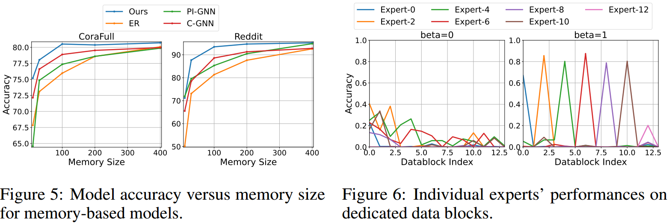
ATAI
AdvancedTechniqueof
Artificial Intelligence
ATAI
ChongqingUniversity _{AdvancedTechniqueof}
of Technology Artificial Intelligence
ChongqingUniversity of Technology
Experiments

Slide 10
ATAI
AdvancedTechniqueof
Artificial Intelligence
ATAI
ChongqingUniversity _{AdvancedTechniqueof}
of Technology Artificial Intelligence
ChongqingUniversity of Technology
Experiments

Slide 11
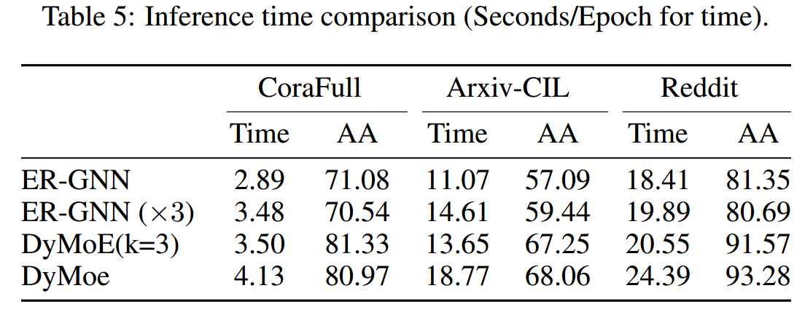
ATAI
AdvancedTechniqueof
Artificial Intelligence
ATAI
ChongqingUniversity _{AdvancedTechniqueof}
of Technology Artificial Intelligence
ChongqingUniversity of Technology
Experiments

Slide 12
ChongqingUniversity of Technology
ATAI
AdvancedTechniqueof
Artificial Intelligence
ATAI
ChongqingUniversity _{AdvancedTechniqueof}
of Technology Artificial Intelligence
Thanks!

